Slide 1
Worldwide Suicide Factors
Nash Delcamp, Keith Kunz, and Allison Roth

Slide 2
Problem and Data
Costs of suicide:
Approximately 800,000 people commit suicide, while even more attempt suicide¹
It is estimated that 10 to 15 percent of patients who engage in medically serious suicide attempts will die by suicide within 10 years²
Total cost is $93.5 billion, or $298 per capita in US alone²
Emotional tolls on family, friends and community members can last years.
Where to focus prevention efforts?
Data:
WHO suicide data for 1985 - 2016
Wikipedia data on gun ownership by country
Wikipedia data on internet usage by country
Final data:
101 countries over 26 years
Other variables include metrics on GPD, sex, age, population, civilian firearms, registered and unregistered firearms and internet usage.
Notes:
AR

Slide 3
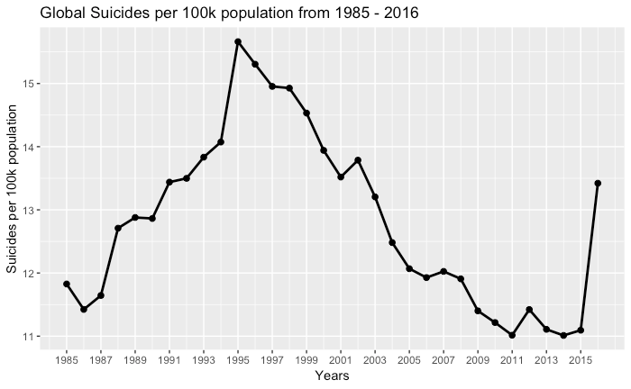
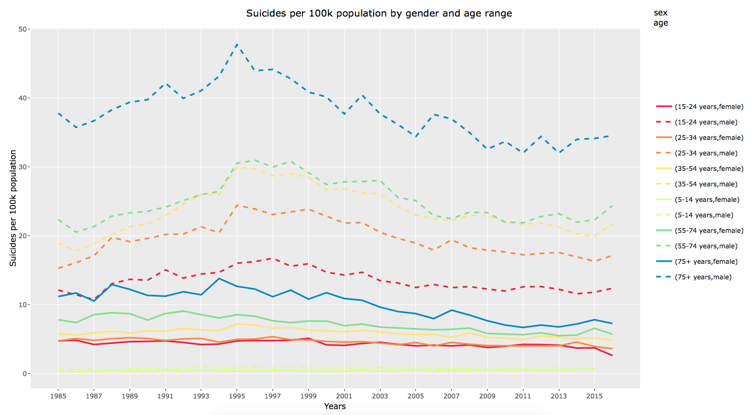
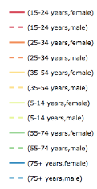
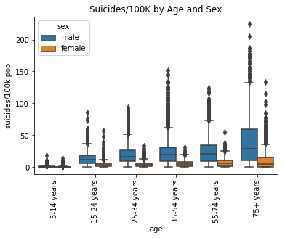
Suicide Trends
Suicide rates peaked in 1995
Declining since, with an uptick in 2016
We anticipate this to be an anomaly; that was an incomplete year for data
Males 75+ years of age have the highest rate
Females 5 -35 have low suicide rates
Males have higher rates of suicide in every age category
Older → higher rate both male and female
v
Notes:
AR

Slide 4
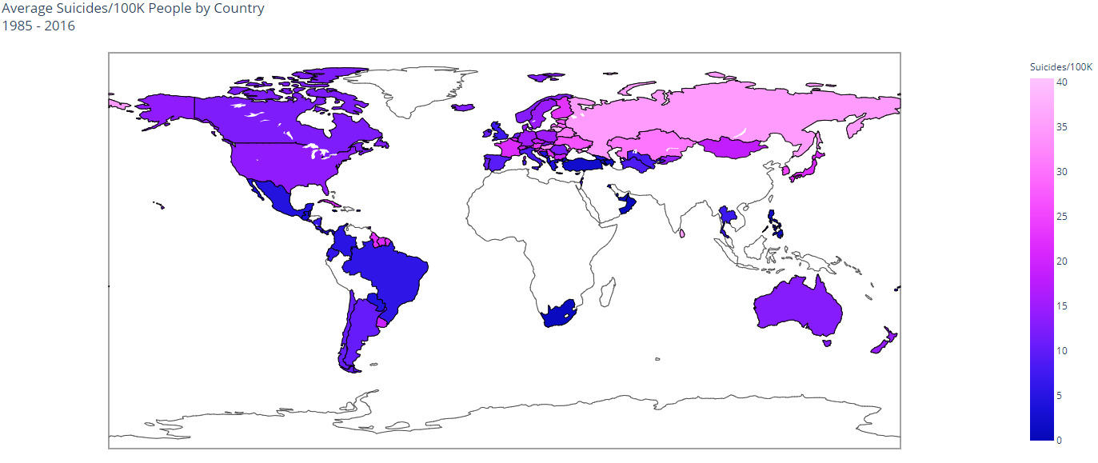
Global View
-Light colors correspond to high suicide rates, darker colors are lower suicide rates.
-North and South America generally lower rates with some higher countries, Europe a mix and Asia with some higher rates
-Sparse data in Africa, parts of the Middle East and Southern Asia
Notes:
As we moved through the exploratory data analysis we wanted to vizualize the suicide rate by country. The data was over-layed as shown here and Light colors correspond to high suicide rates, darker colors are lower suicide rates. North and South America generally lower rates with some higher countries mixed in, Europe was a mix of rates and Asia with some of the higher rates. Of the data that was available, you can see that reporting in Africa and parts of Asia are sparse at best. From here we moved into modeling, starting with a multiple linear regression model.

Slide 5
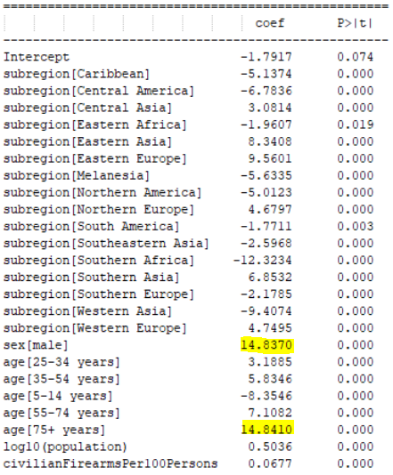
Simple Model, Big Conclusions
Multiple linear regression:
R-Squared: 0.397
Males significantly increase the suicide rate
As age increases, so does suicide rate
Population and Civilian firearm ownership rate slightly increase with suicide rate.
Southern Africa and Western Asia regions decrease the rate the most
Eastern Europe and Eastern Asia increase the suicide rate the most
Notes:
One of the first models that we looked at was a MLR model. Iterating through all of the variables we had joined into our data we arrived at the model with the output as shown here. This model was the result of only 5 variables, being subregion, sex, age, log of the population and civilian firearm ownership rate. These were the only variables that had significant p-values. The R-squared is not spectacular, but it reiterated what the exploratory data analysis had shown us. Males are much more likely to commit suicide and raise the rate of suicide by 14.8 as well as the trend that the older age group, the higher the suicide rate, especially for ages 75+. As you can see as well, Population and Civilian firearm ownership rate slightly increase with suicide rate. This is an interesting observation as it shows there is some correlation with amount or firearms owned and the suicide rate. As for the subregions, Southern Africa and Western Asia decrease the rate the most while Eastern Europe and Eastern Asia increase the suicide rate the most. From here, we moved to a K-means clustering analysis which Nash will discuss.

Slide 6
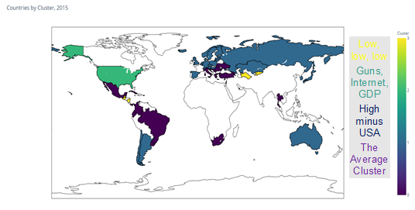
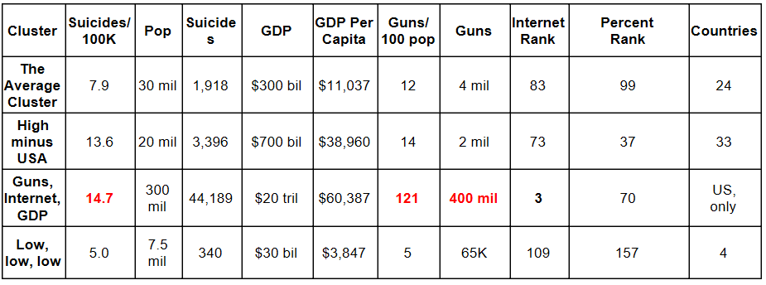
Is the US alone?
K-Means model
Subset to 2015
Clustered using number of guns and percentage of internet accessibility, only.
Notes:
ND

Slide 7
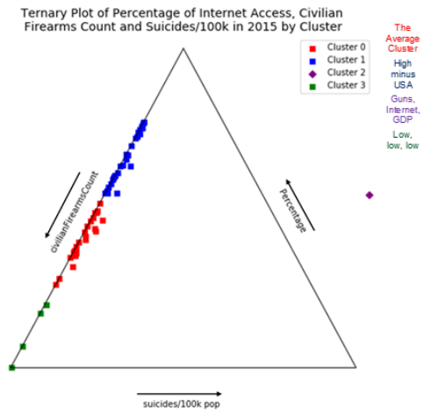
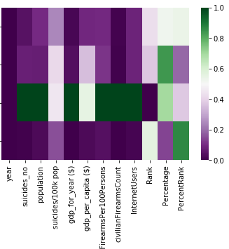
US (alone) Far From Other Clusters
Heatmap by Cluster
The Average Cluster
High minus USA
Guns, Internet, GDP
Low, Low, low
US
Notes:
ND

Slide 8
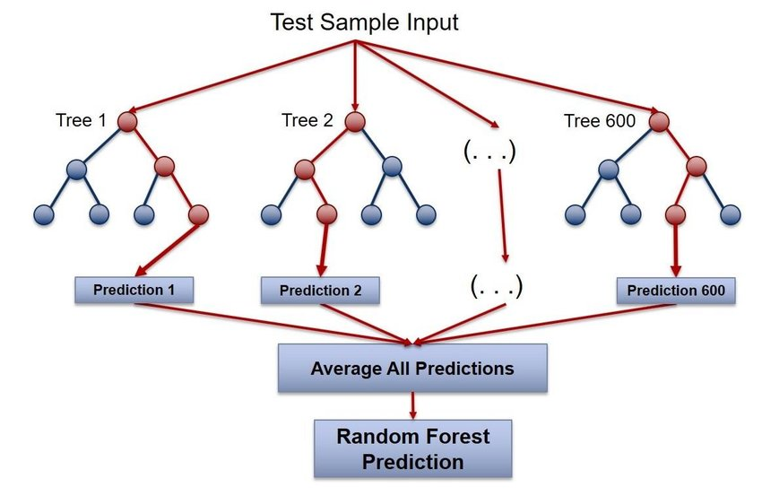
Predicting Rate of Suicide
Random Forest
Base RMSE = 19 (suicides/100k)
Model without age or sex* RMSE = 12
Model with age and sex RMSE = 7
Struggles with low population countries
1 suicides / 500 people → 200 suicides/100k
2 suicides / 500 people → 400 suicides/100k
*year, population, civilianFirearmsPer100Persons, civilianFirearmsCount, InternetUsers, Rank, Percentage
Max depth = 16; max features = auto (sqrt)
Notes:
ND

Slide 9
Recommendation
As seen throughout the data analysis and modeling, the prevailing factors and metrics that determine the suicide rate are age and sex. As age increases, agnostic of sex and other factors, the suicide rate also increases with the older age groups having significantly higher rates. The rate also significantly increases if you are a male.
As a result, it will be important to look at factors that affect both the male and elder population propensity to commit suicide. It will be important that countries around the world focus their efforts on understanding this problem and commit resources to help prevent such tragic events.
Notes:
AR

Slide 10
Future Considerations
Many other factors may help explain the suicide data that has been analyzed here. Future analysis can build on this framework by including other data and sources including, but not limited to:
Mental health spending and prevalence of mental health issues
Alcohol and drug use
Family status
Social inclusion
Chronic disease rates
Incarceration rates
Bullying
Building on this data may help find factors that better determine the best preventative actions to take with available resources.
Notes:
KK

Slide 11
References
¹ Suicide Key Facts - World Health Organization - https://www.who.int/en/news-room/fact-sheets/detail/suicide
² Financial Cost of Suicide in U.S. Nearly Twice Previously Thought https://edc.org/financial-cost-suicide-us-nearly-twice-previously-thought
³ Random Forest Visualization https://www.researchgate.net/figure/Random-Forest-visualization_fig11_326560291

